Slide 1

APACHE FLINK
A presentation by Saumya (018807852)
And Abbasali Gulabiwala (017056895)

Slide 2
Overview
Introduction
Use Case
Flink Process Flow
Demo
References

Slide 3
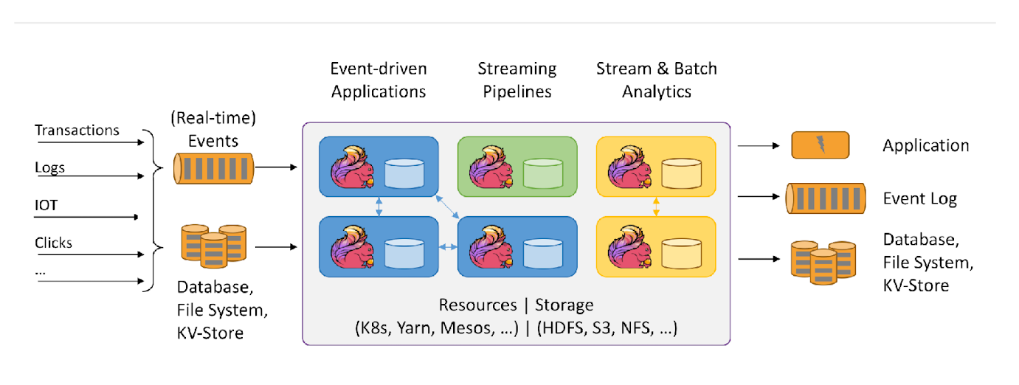
Introduction
Apache Flink is an open-source stream processing framework.
Low Latency
High Throughput
Stateful
Distributed

Slide 4

What is Apache Flink?
Data Stream Processing
realtime results from data streams
Event-driven
Applications
data-driven actions and services
Batch Processing
process static and historic data

Slide 5
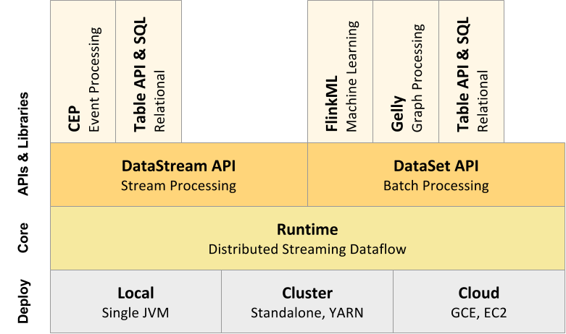
Flink component stack

Slide 6
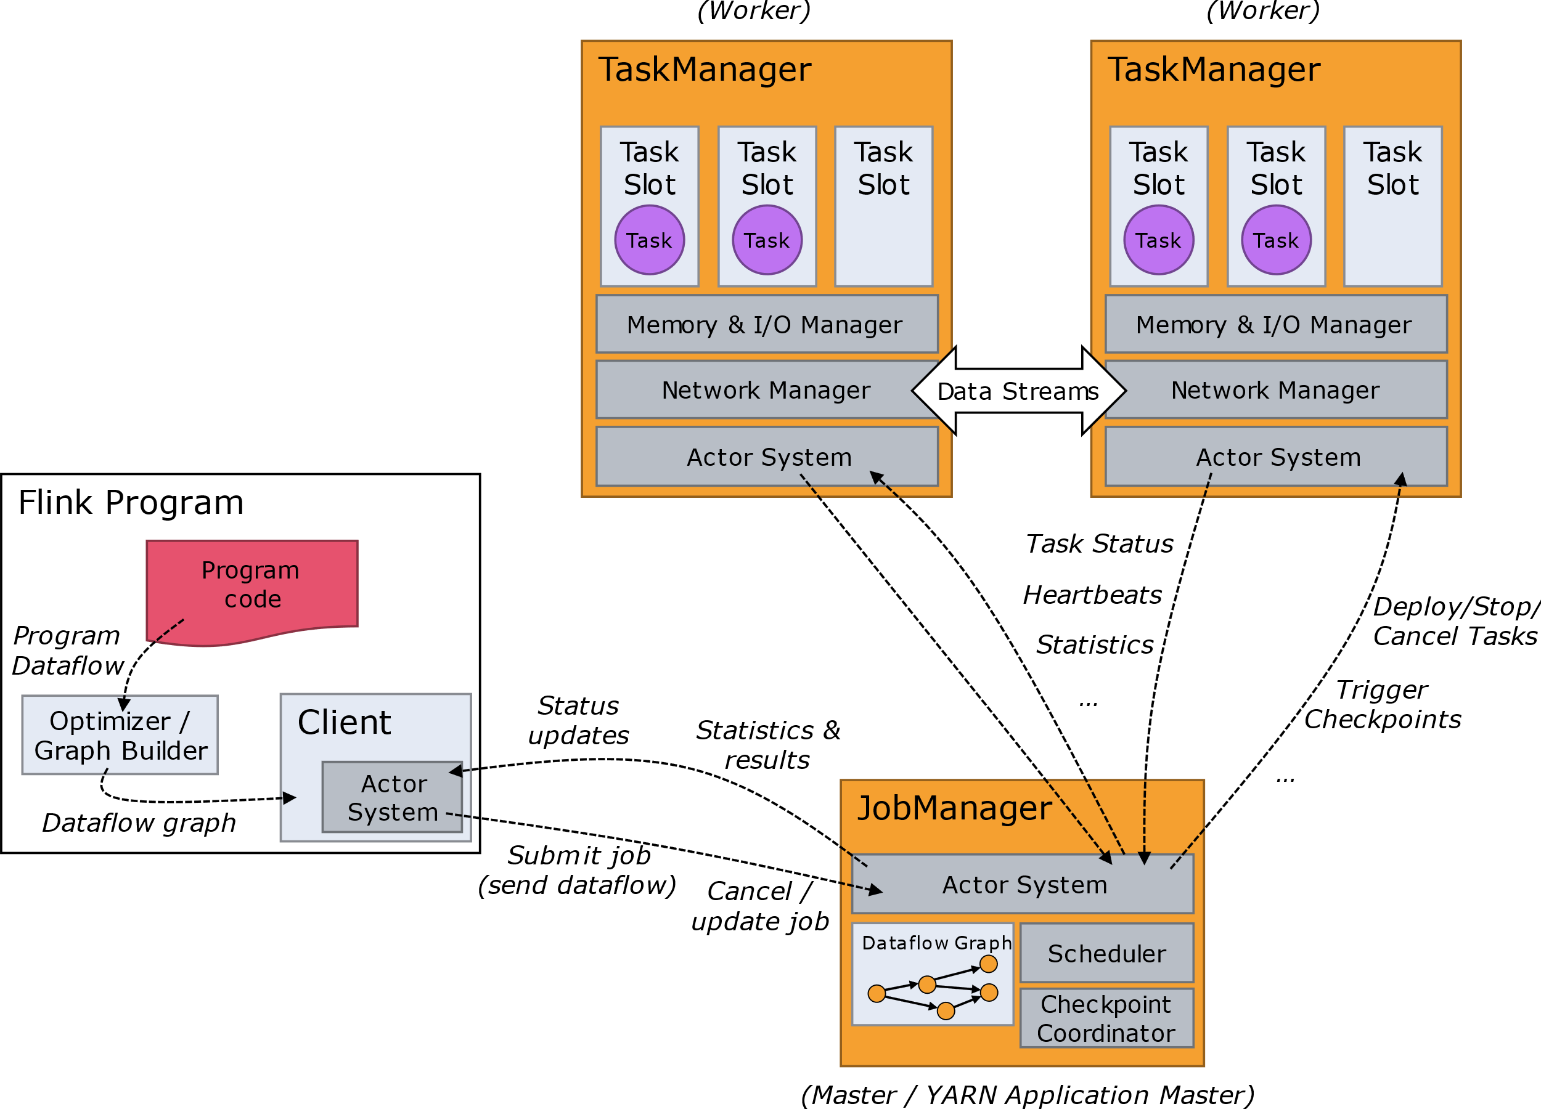
FLINK PROCESS FLOW

Slide 7
Data Source and Data Sink
Data Sink
Data sinks consume DataStreams and forward them to files, sockets, external systems, or print them.
Data Source
Sources are where your program reads its input from. You can attach a source to your program by using StreamExecutionEnvironment.addSource(sourceFunction).

Slide 8
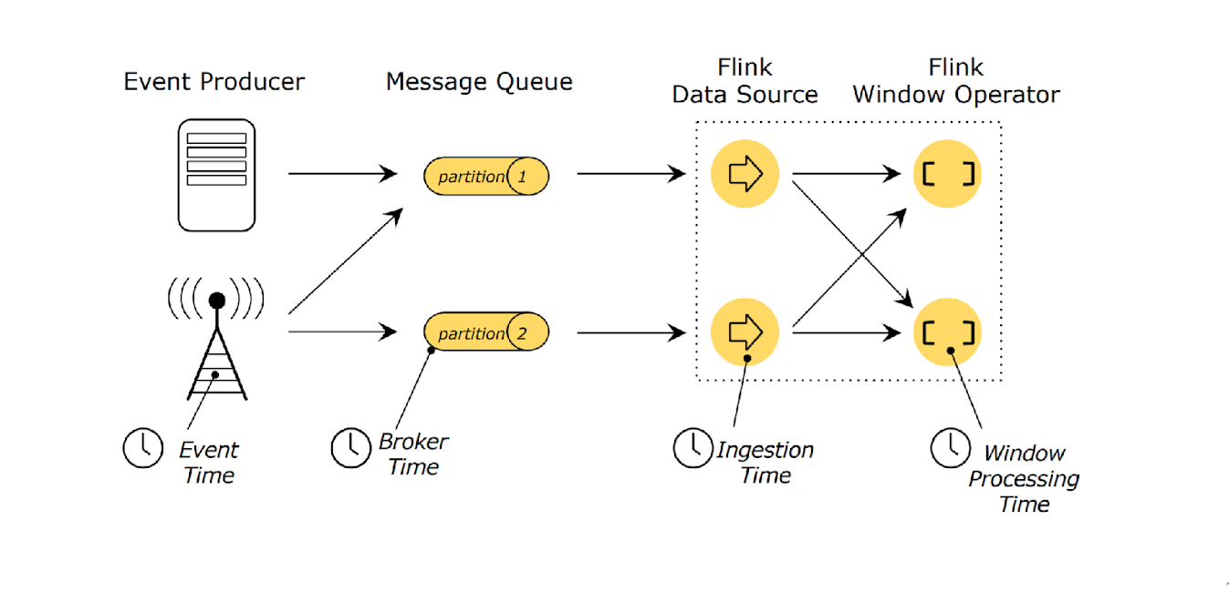
Time: Different Notions of Time

Slide 9
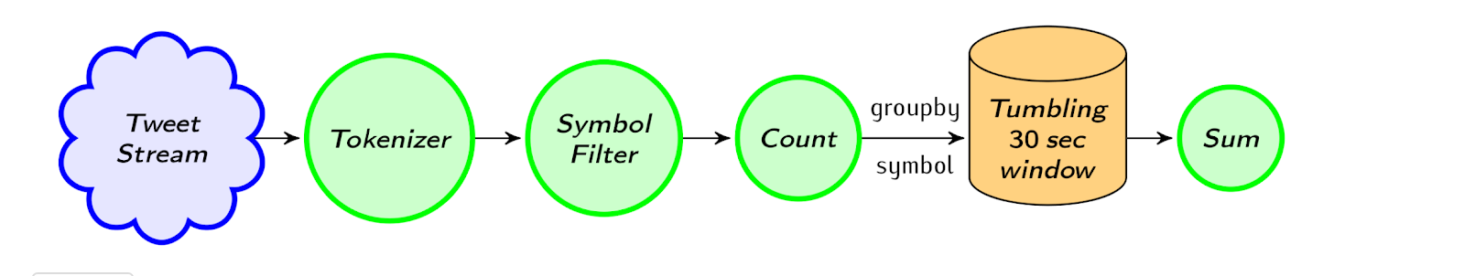
Process Flow

Slide 10
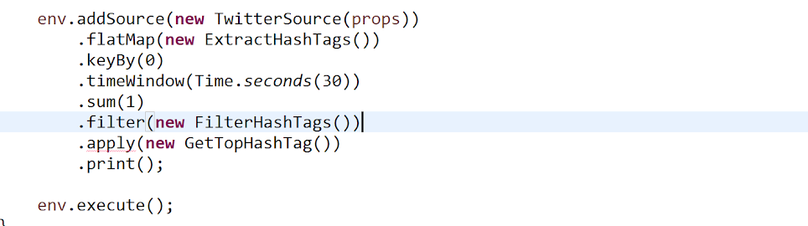
Event Execution Environment setup function

Slide 11
Demo

Slide 12
references
Carbone, Paris, et al. "State management in Apache Flink®: consistent stateful distributed stream processing." Proceedings of the VLDB Endowment 10.12 (2017): 1718-1729.
Dinsmore, Thomas W. "Streaming analytics." Disruptive analytics. Apress, Berkeley, CA, 2016. 117-144.
Carbone, Paris, et al. "Apache flink: Stream and batch processing in a single engine." Bulletin of the IEEE Computer Society Technical Committee on Data Engineering 36.4 (2015).
Katsifodimos, Asterios, and Sebastian Schelter. "Apache flink: Stream analytics at scale." In 2016 IEEE international conference on cloud engineering workshop (IC2EW), pp. 193-193. IEEE, 2016.
https://flink.apache.org

